Slide 1
Location Services
Android Development

Slide 2
Location Services
A key advantage of a mobile device is that it knows where it is. You can offer tailored experiences based on location
Provide mapping and location services
What's nearby?
You can target advertising. Demographic data
Geofencing opportunities
Understand user's context

Slide 3
Technology involved
Mobile Towers
Wifi Networks
GPS - Global Positioning Satellites

Slide 4
Technology - Mobile Towers
A device can usually "see" multiple mobile towers
Distance is approximated by signal strength
Triangulation is used

Slide 5
Triangulation
Device Sees:
Tower 1 : 30% power
Tower 1

Slide 6
Triangulation
Device Sees:
Tower 1 : 30% power
Tower 1

Slide 7
Triangulation
Device Sees:
Tower 1 : 30% power
Tower 2 : 50% power
Tower 1
Tower 2

Slide 8
Triangulation
Device Sees:
Tower 1 : 30% power
Tower 2 : 50% power
Tower 1
Tower 2

Slide 9
Triangulation
Device Sees:
Tower 1 : 30% power
Tower 2 : 50% power
Tower 1
Tower 2
Must be in this area

Slide 10
Triangulation
Device Sees:
Tower 1 : 30% power
Tower 2 : 50% power
Tower 3 : 90% power
Tower 3
Tower 1
Tower 2
Adding a 3rd tower gets us closer

Slide 11
Mobile Tower Triangulation
Accuracy: 4 miles to 50m, depends on
How many towers are in area
Terrain
On average: about a 1/4 mile
Only 2D
Works indoors

Slide 12
Mobile Tower Triangulation
Always "on"
Required by E911 Systems
Built into mobile network technology
Apps can get a location fast
Still requires permission from OS

Slide 13
Wifi Positioning
Like towers, works by triangulation
Scans for local Wifi signals ("fingerprints")
MAC Address
SSID (Network names)
Signal strength
Works even if you’re not signed in
Databases of crowdsourced information
People driving around, scanning with laptops
Google StreetView

Slide 14
Wifi Positioning
Accuracy: meters
Works in urban areas
Works great indoors
Example: Home Depot provides Wifi info to Google to help people find items down to a few feet within store aisles
Works Vertically
Has to communicate with server to get location info

Slide 15


Vertical Triangulation
4th Floor AP
Probably on Floor 2
1st Floor AP

Slide 16
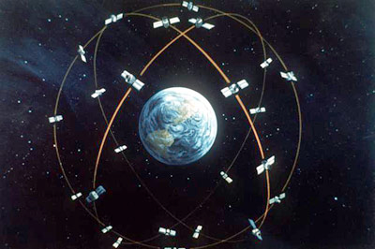
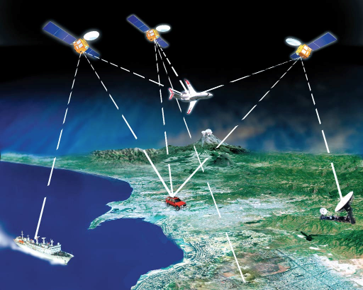
GPS
GPS - Global Positioning System
Works with satellites
Position by triangulation
Distance based on time

Slide 17
GPS
Advantages:
Most accurate
"Worst case" is 7m, usually more accurate
Not very good indoors
Works vertically
Once locked, movement is quick to track

Slide 18
GPS
GPS - Global Positioning System
Disadvantages
Slow to get initial "lock" : 2 minutes
Works poorly indoors
Battery drain

Slide 19
Other Location Technologies

Slide 20
Beaconing
Knowing you are in close proximity to a point of interest
Apple's iBeacon
Bluetooth LE based technology

Slide 21
Beaconing
Hardware on device detects the presence of a local beacon
ID of beacon is cross referenced with an online database to determine location

Slide 22
GeoFencing
Having an app take an action when a user crosses into a defined location
Google Now
Google Play Services
"Remind me when I get home to..."
Provide a grocery list when at a Target

Slide 23
GeoFencing
Has been taking a while to develop
Requires constant knowledge of users' device location, so it can be a drain on battery
New strategies + new technologies making it more possible
Low Battery use
Beaconing

Slide 24
Activity Recognition
An extension of the data provided by Location Services (and other sensors)
Devices lets you know what it thinks the user is doing
Walking
Driving
Bicycling
Standing Still
Google Play Services

Slide 25
Maps
Maps are not built in
Map data is intellectual property and requires servers to support
MapViews are provided by Google Play Services (and Amazon Kindle API)

Slide 26
Android Locations Services
Service is provided by operating system
Don't have to do triangulation yourself
Still need to understand network based and GPS-based location services
"Network Provider" = Mobile network or Wifi
"GPS Provider" = GPS

Slide 27
Strategies
Use GPS or Network?
Why not both?
Initial location provided by a cell network or Wifi service
Switch to GPS once there is a lock
The "circle" that shrinks when you use some mapping programs

Slide 28
Strategies
Use getLastKnownLocation if possible
Save battery life
Immediate response
Often good enough
Use less accurate locations until you get an accurate location
GPS may take a while (or never come)
Stop listening or throttle updates when you have a good answer
http://developer.android.com/guide/topics/location/strategies.html

Slide 29
Location Services on Android
Request permission in AndroidManifest.xml. Two options
// COARSE Network only. Does not use GPS
<uses-permission android:name= "android.permission.ACCESS_COARSE_LOCATION"/>
// FINE uses GPS plus network <uses-permission android:name= "android.permission.ACCESS_FINE_LOCATION"/>

Slide 30
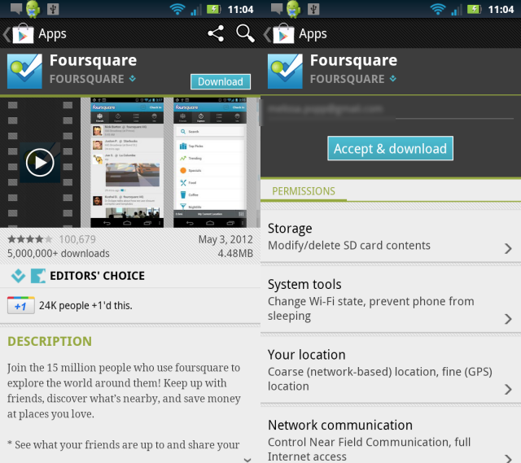
Location Services on Android
Request permission in AndroidManifest.xml. Shows up when they download the app

Slide 31
Location Services on Android
Get the LocationManager
LocationManager locationManager = (LocationManager)getSystemService(Context.LOCATION_SERVICE);
Create a listener (LocationListener)

Slide 32
Location Services on Android
Register for updates (usually in onResume)
locationManager.requestLocationUpdates(
name of provider
interval – Minimum interval in milliseconds
distance – Minimum distance between
updates, in meters
name of listener
The Listener is an instance of LocationListener

Slide 33
Location Services on Android
Unregister updates* (usually in onPause)
Do something with Locations

Slide 34
Location Services Sample Program
Show “MyLocation” program.

Slide 35
Location Services Best Practices
The more accurate the location, the more it drains your battery
Faster updates drain the battery faster
GPS can take a long time, on the order of minutes, to determine location
Monitor provider status to make sure the best alternative is used at all times

Slide 36
Using Proximity Alerts
private void setProximityAlert() {
double lat = 73.147536;
double lng = 0.510638;
float radius = 100f; // meters
long expiration = -1; // do not expire
Intent intent = new Intent(TREASURE_PROXIMITY_ALERT);
PendingIntent proximityIntent = PendingIntent.getBroadcast(this, -1, intent, 0);
locationManager.addProximityAlert(lat, lng, radius, expiration, proximityIntent);
}

Slide 37
Set Up Location Listener
// Acquire a reference to the system Location Manager LocationManager locationManager = (LocationManager)
this.getSystemService(Context.LOCATION_SERVICE); // Register the listener with the Location Manager to receive location updates locationManager.requestLocationUpdates(LocationManager.NETWORK_PROVIDER,
0, 0, locationListener);
Implement the LocationListener as an inner class, shown on the next slide.

Slide 38
Location Listener
// Define a listener that responds to location updates LocationListener locationListener = new LocationListener() { public void onLocationChanged(Location location) { // Called when a new location is found by the network location provider. makeUseOfNewLocation(location); } public void onStatusChanged(String provider, int status, Bundle extras) {} public void onProviderEnabled(String provider) {} public void onProviderDisabled(String provider) {} };

